Slide 1

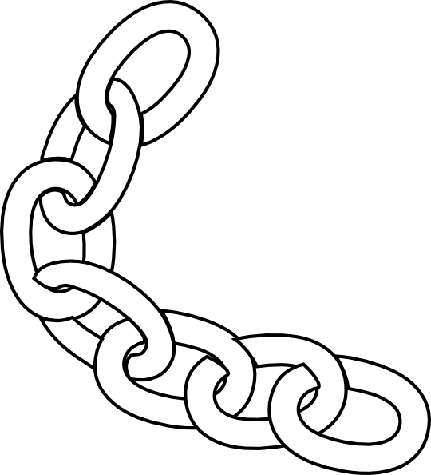

 | Renton Fish & Game Club Bay 5 Stage: Corn Pop and the Bad Boys Course Designer: Kris Erickson
Corn Pop was a bad dude, and he ran a bunch of bad boys. He wouldn't listen and wear his bathing cap.I said, "Hey, Esther, you! You get off that board, or I'll drag you off!” He came off and he said, "I'll be waiting for you!" There were three guys with rusty straight razors. --Not a joke— There's a guy named Bill Wright-Mouse, the only white guy, and he did ALL the pools. He was the mechanic. He cut off a six foot length of chain and he said, "you walk out with that chain, and you say, 'you may cut me man, but I'm gonna wrap this chain around your head.’“ I was smart. Then. --- Joe Biden, September 15, 2019. SCENARIO: Standards
START POSITION: Standing at P1, chain held in strong hand. Handgun loaded and holstered. Wrists below belt. PCC loaded, stock on belt, muzzle pointed downrange. |  | STRINGS: 1 SCORING: Unlimited SCORED HITS: Best 3 ROUND COUNT: 12 TARGETS: 4 IDPA START-STOP: Audible - Last shot CONCEALMENT: Required Muzzle Safe Points: 180 degree rule SO NOTES:
STAGE PROCEDURE: At the start signal, engage T1-T4 in tactical priority with at least 3 shots each. NOTES:
T4
T3
T2
T1
P1
https://www.youtube.com/watch?v=r4NmtSrqtvI

